Slide 1
CARDLESS TRANSACTION USING RETINAL SCAN
Submitted By:
Anusha Anil Shet
Manikya Aravinda
Tanya Varghese

Slide 2
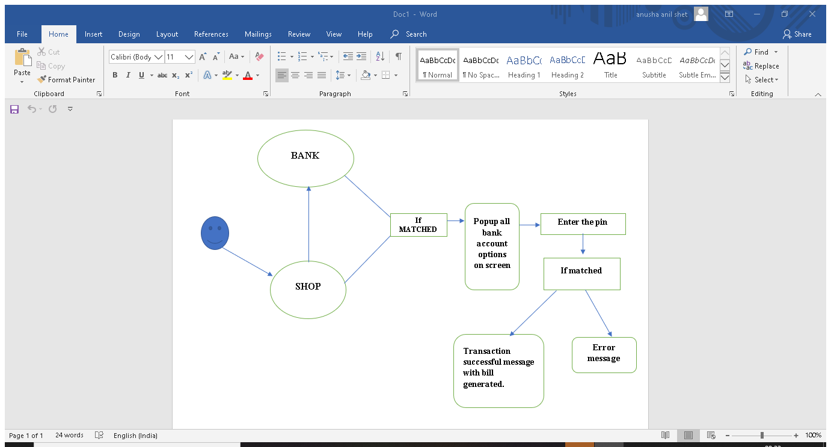
Flowchart:

Slide 3
Explanation:
Firstly we have created the database where we are storing all the data’s of a person and there is an other database of bank. As our Adhar is linked with all of our bank accounts which even includes the retinal scans also which we gave for Adhar card generation.
When the user goes to a shop without even carrying phone, wallet, card etc he just need to scan his retina through the scanner once its scanned that image gets encrypted through Md5 hashing and gets compared with the bank stored retrinal database where both should be of same format if both of them matches then user gets the multiple accounts linked to him on the screen which ever bank he wants to choose he can and then he gets a pop up to enter the pin which is known only to him and the bank in encrypted form. Once he enters that pin and give submit respective money from his bank gets deducted and a e-bill is generated. Thus this is how it works.
This can also be done with more secure features using Blockchain.

